Slide 1
Visualizing the Scripts of
Data Wrangling
with SOMNUS
Group 9
陳弘翔 313551169 郭建廷 313551072 黃俊翔 312612305

Slide 2
Reference
Visualizing the Scripts of Data Wrangling with SOMNUS
IEEE Transactions on Visualization and Computer Graphics 2022
Current citations: 19
Authors
Kai Xiong
Siwei Fu
Guoing Ding
Zhongsu Luo
Rong Yu
Wei Chen
Hujun Bao
Yingcai Wu

Slide 3
Outline
Introduction
Method
User Interface
Result
Case Study
Conclusion & Future Work

Slide 4
Introduction

Slide 5
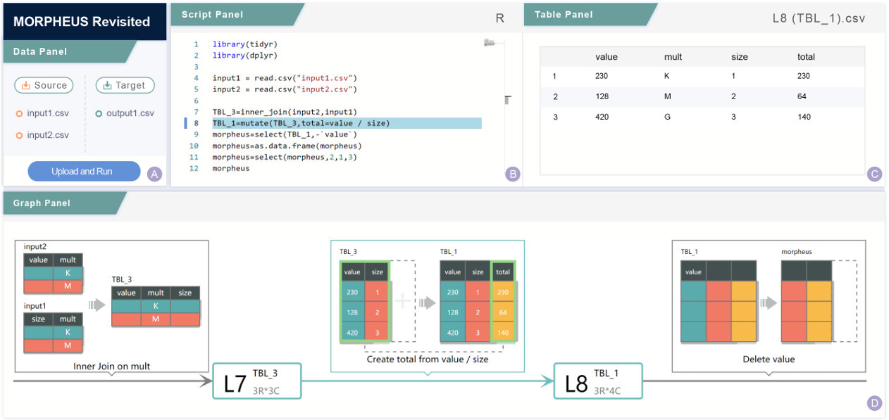
Introduction
SOMNUS
Web-based client-server system
Built in flask, Vue.js, D3.js
Data wrangling for table manipulation in R and Python

Slide 6
Motivation
Data Wrangling
Data transforming
Reformatting
Integrating data
To wrangle data, data workers need proficiency in programming languages like R or Python, along with relevant toolkits.

Slide 7
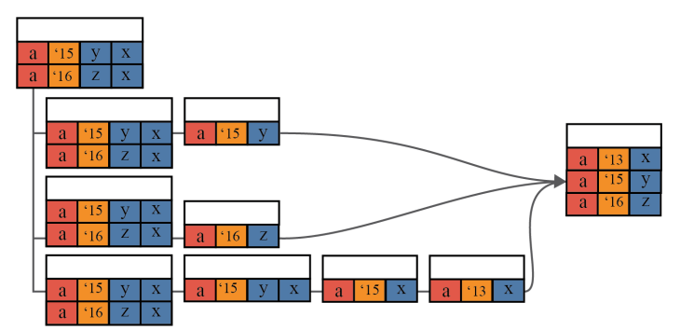
Related work
Kasica et al. [1] formed 21 types of operations for data wrangling by two dimensions (e.g. tables)
each type of operation is represented by icon, but not mapped to data.
[1] S. Kasica, C. Berret, and T. Munzner. Table Scraps: An actionable framework for multi-table data wrangling from an artifact study of computational journalism.

Slide 8
Contribution
Design 23 different glyphs for two dimensions design space
Propose a pipeline, SOMNUS, that visualizes the creation and evolution of data tables across a series data transformations
A controlled study that evaluate the comparison between visualization description and text description
Apply SOMNUS to two example applications
Double-checking
MORPHEUS

Slide 9
Method

Slide 10
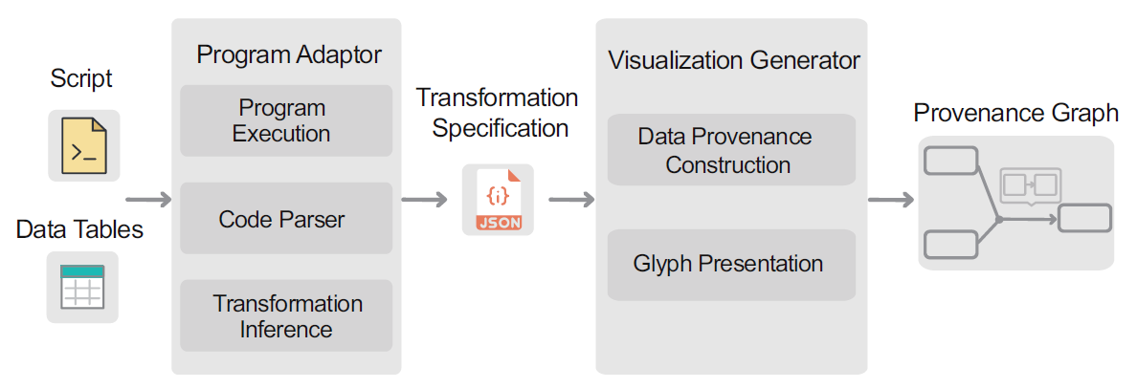
Architecture of SOMNUS

Slide 11
Architecture of SOMNUS - Program Adaptor
Program Adaptor aims to generate a series of transformation specifications from given data tables and script

Slide 12
Program Execution
The primary goal of this step is to obtain input and output data for each function

Slide 13
Code Parser
Extracts input/output table names, function names, and parameters from each line of code to build data transformation specifications.

Slide 14
Architecture of SOMNUS - Program Adaptor
Maps each function in a script to a specific type of data transformation.
filter -> Delete Rows

Slide 15
Architecture of SOMNUS - Visualization Generator
Visualization Generator aims to generate visual representation depicting both an overview and detailed information for transformations.

Slide 16
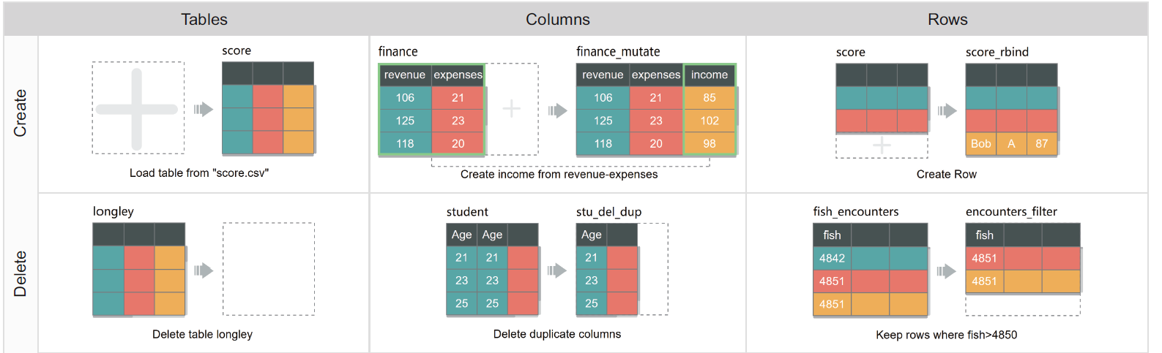
Glyph Representation

Slide 17
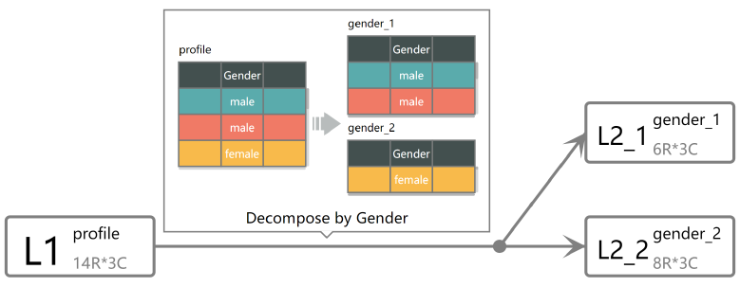
Provenance Graph
Using Eclipse Layout Kernel for positing graph nodes

Slide 18
User Interface

Slide 19
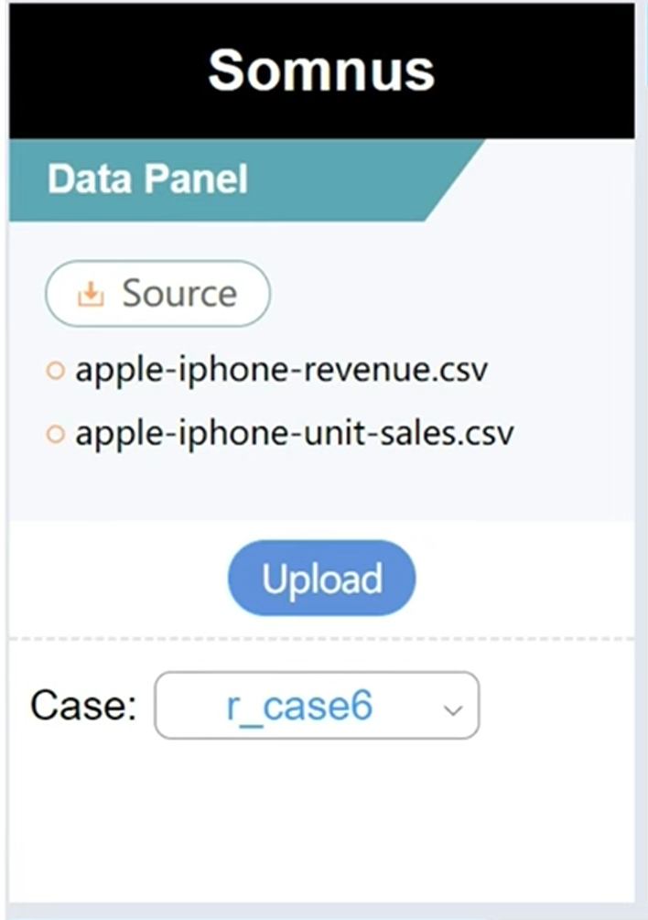
User Interface - Data panel
Users can upload data files by clicking the Source button

Slide 20
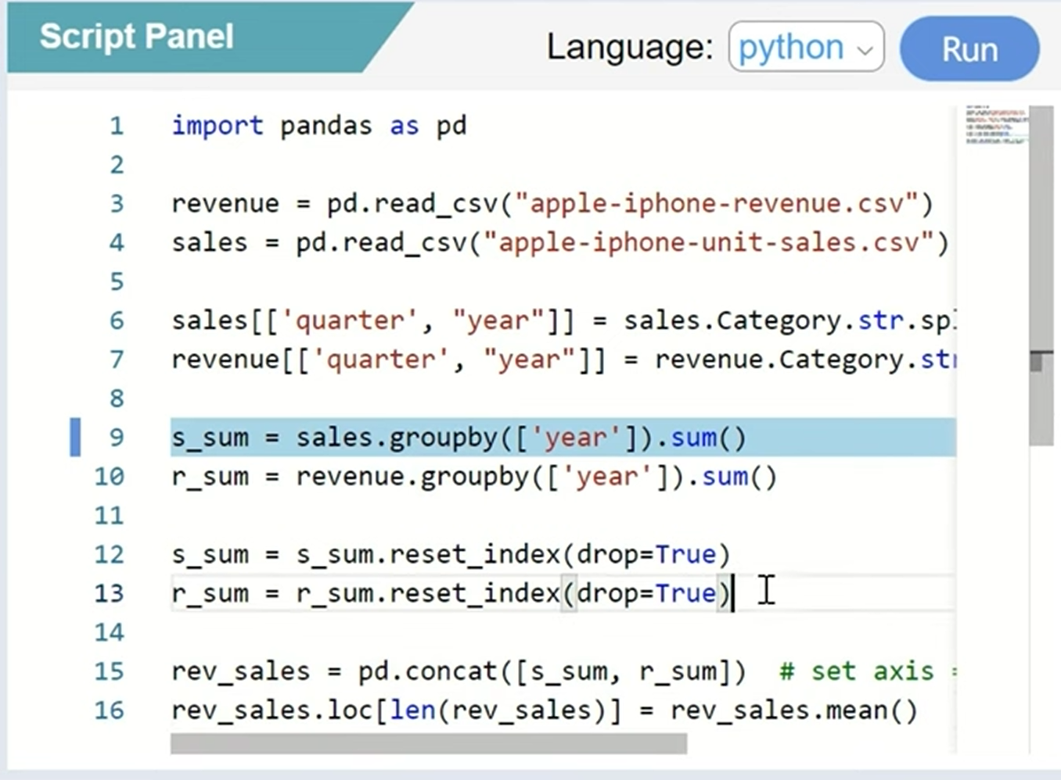
User Interface - Script Panel
Users can put the script that is used to wrangle the data in the script panel
Users can choose the language of the script with the dropdown list
After clicking the “Run” button, the script will be executed and graphs will be generated in the graph panel

Slide 21
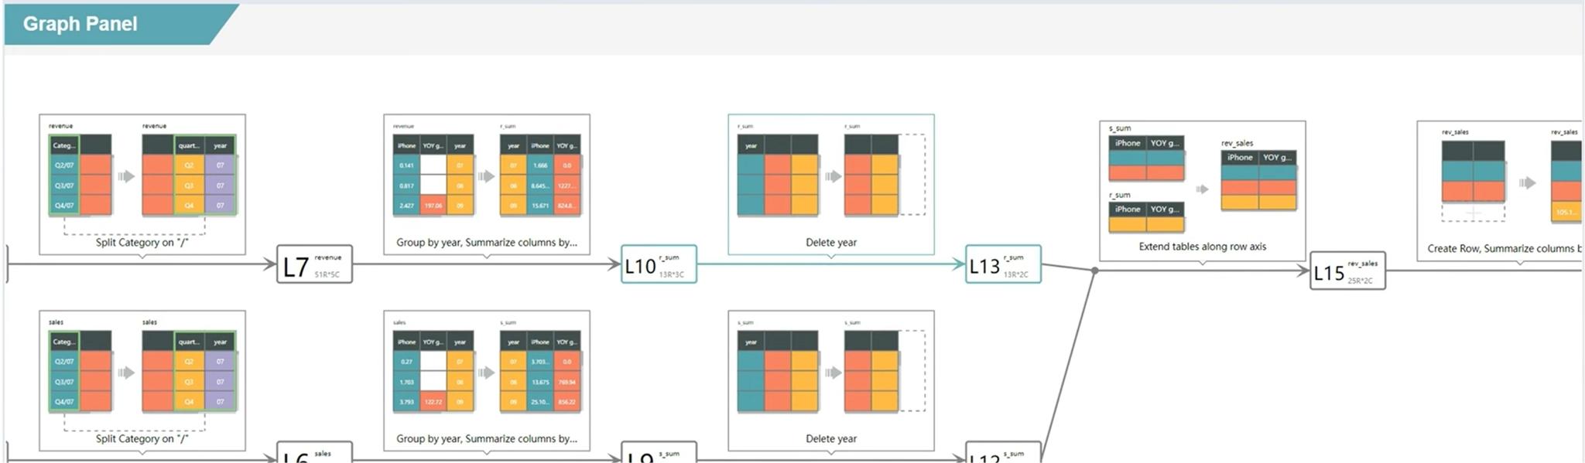
User Interface - Graph Panel
Graphs here are the data transforms implemented in the script
Data transforms are visualized so that it becomes easier for users to know how the data get transformed

Slide 22
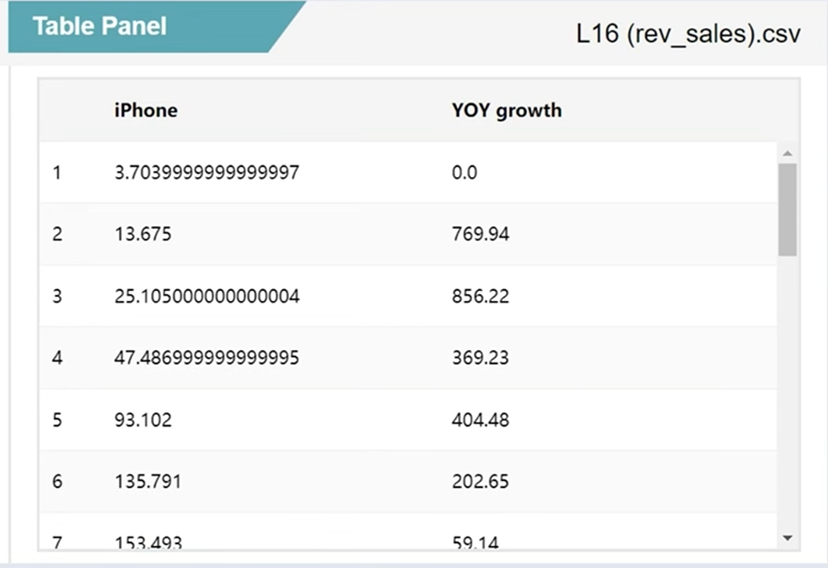
User Interface - Table Panel
Here shows how the table looks like after a data transform

Slide 23
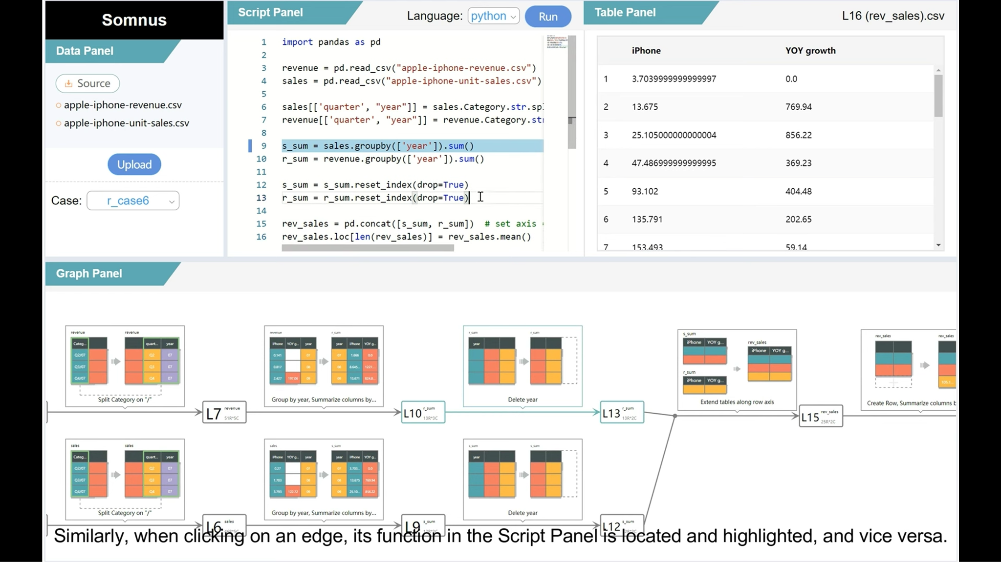
User Interface - Whole Picture

Slide 24
Result

Slide 25
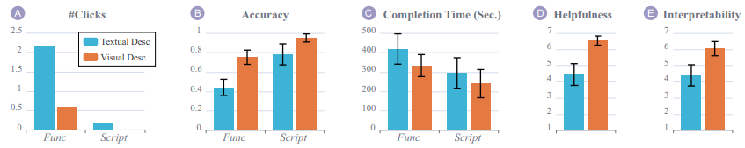
Result - Definition
Textual Description
Baseline
Without glyphs
Visual Description
Original textual descriptions are removed
Glyphs are used instead
Func focused on the semantics of individual functions, including the output tables and operations.
Script focused on the understanding of data provenance through
a sequence of functions

Slide 26
Result - Explanation
(A) shows the average number of clicks to expand the function documentation and data tables
For (D) and (E) they ran Mann-Whitney’s U tests to evaluate the difference in the responses of their seven-point Likert Scales
In terms of Helpfulness, their technique (µ = 6.55, σ = 0.61) significantly more helpful in assisting participants to understand transformation than textual descriptions (µ = 4.45, σ = 1.43): U = 34.5, p < 0.01.
In terms of interpretability, their technique (µ =6.05, σ = 0.95) was easier to understand than textual descriptions (µ = 4.40, σ = 1.39): U = 71, p < 0.01.

Slide 27

Case Study
Double-checking
MORPHEUS Revisited

Slide 28
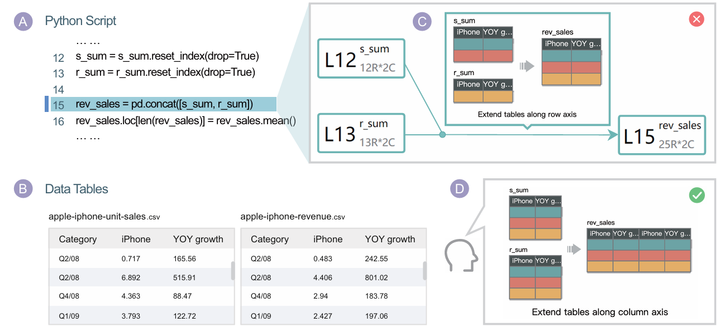
Double-checking
Save a lot of time
Decrease the manpower and budget
Automation can reduce human errors

Slide 29
MORPHEUS Revisited
Easy to understand
Observe the detail of data transformation(Step by step)
User-friendly(The GUI is easy to operate)

Slide 30
Conclusion & Future Work

Slide 31
Conclusion
Develop visualization techniques
illustrate the semantics of code pieces in data transformation.
Derive glyphs targeting 23 types of transformations
Design pipeline
code pieces and data tables → a graph of data transformations.
Helping users understand data transformations through the visualization

Slide 32
Future Work
Increase support for more data transformation functions and operations
Develop automatic mapping algorithms
Enhance support for more complex control flows (such as loops and conditional statements)

